Slide 1


DS 202 Final Presentation
Sonya Haan
Connor Hergenreter
Andrew Maloney
Elaine Oldbear

Slide 2
Military Expenditure
Arms Imported
Military Personnel
Global Firepower
Dataset Background
Started with Military Expenditure
Searched for data to explain what militaries spend money on
Current USD
Share of GDP
Notes:
We started our project by working with a dataset from the Stockholm International Peace Research Institute (SIPRI) about the military expenditures of 172 different countries from the year 1949 to 2017.
For this dataset, SIPRI defines military expenditure as any spending on the military in general. This includes money spent on:
personnel (i.e. the salaries and benefits of troops and civilian staff)
operations and maintenance (i.e. spending on general supplies, services and transport)
military and non-military equipment
construction of military bases
research and development.
Though the military expenditure dataset takes into account all these categories of military spending, it does not break down spending by category. It only reports the total military expenditure for each year.
Originally, we were only working with the military expenditure data, but as SIPRI states, “[military spending] is a financial measure, measuring inputs, and does not necessarily measure military capability.”
We didn’t feel that yearly military expenditure alone could tell the whole story, so we looked deeper into what militaries are spending their money on.
During this search we found 3 other datasets to help us analyze militaries:
Arms Imported
Military Personnel
Global Fire Power
Arms Imported
SIPRI uses a unit of measure called the trend-indicator value to measure the volume of international transfers of major conventional weapons. The trend-indicator value, or TIV, measures transfers of military capability, not the financial value of the arms transfers.
Military Personnel
Presents the armed forces personnel, as a percentage of total labor force. (Data ranges from 1990 to 2016)
Global Firepower

Slide 3
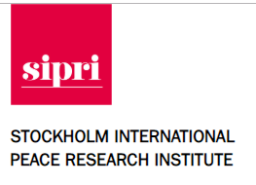
Obtaining the Data
5 data frames
Downloaded data as Excel files
Read in data using read_excel
SIPRI | Kaggle
Military Expenditure: Current USD Military Expenditure: Share of GDP Arms Imported Military Personnel | Global Firepower

Slide 4
Cleaning the Data
Cleaned Excel file before loading data into R
Removed embedded pictures and links
Changed “Year” and “Value” variable type to numeric
Gathered all year columns
Originally had 71 columns: Country, Notes, 1949, … , 2017
Introduced variable in military and map data frames
Joined military data with world map data
Joined on the ‘iso3c’ value
Introduced new variable ‘iso3c’ country code
Notes:
We tried loading the data before removing the pictures and links that were included in the Excel file and ran into issues.
Instead, we chose to remove the pictures and links from the Excel file before loading the data into R.
Before gathering the columns, the data frame from the “Current US$” sheet had 71 columns: Country, Notes, and then a column for each year from 1949 to 2017.
After gathering the columns, the resulting data frame had 7472 rows and 4 columns: Country, Notes, Year, and Value
Finally, we changed the “Year” and “Value” variables to be numeric types

Slide 5
QUESTION 1
How do the strongest and weakest militaries compare? Can we conclude what determines a military’s strength?

Slide 6
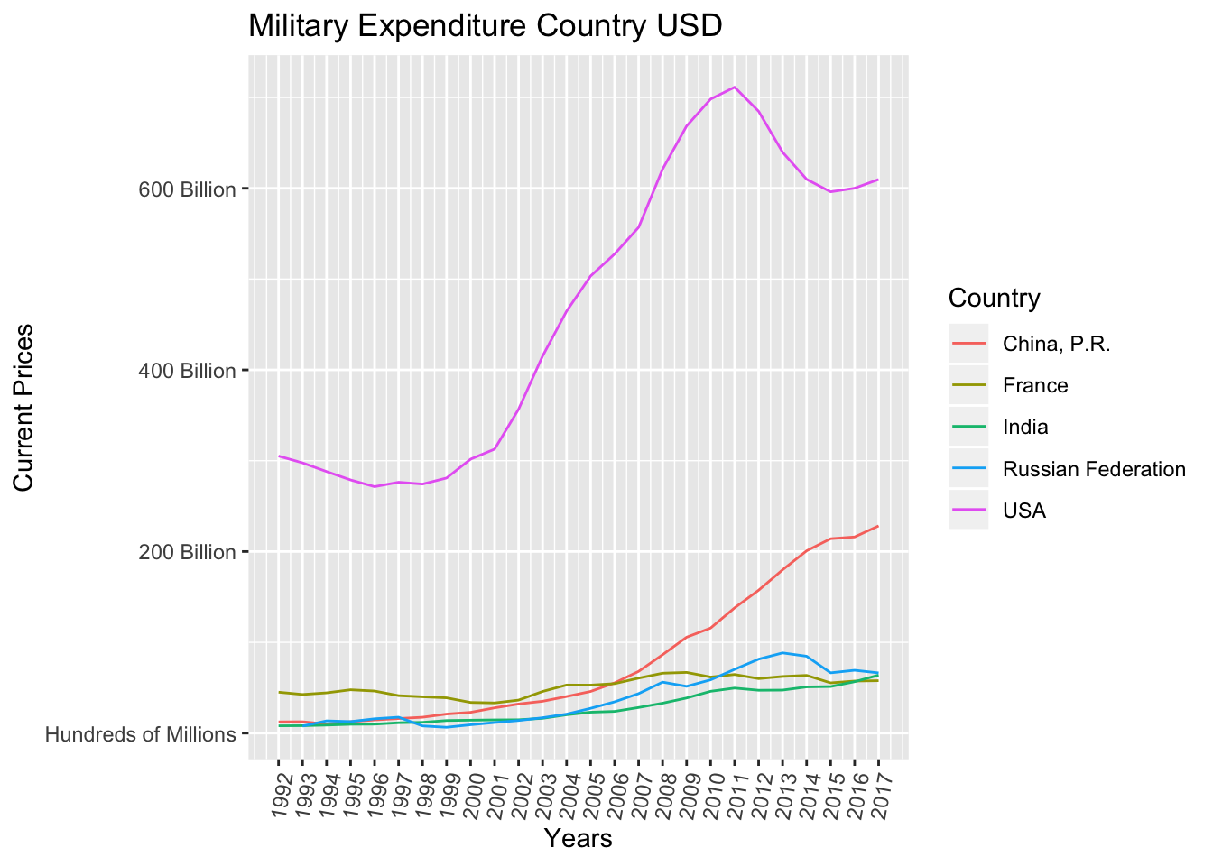
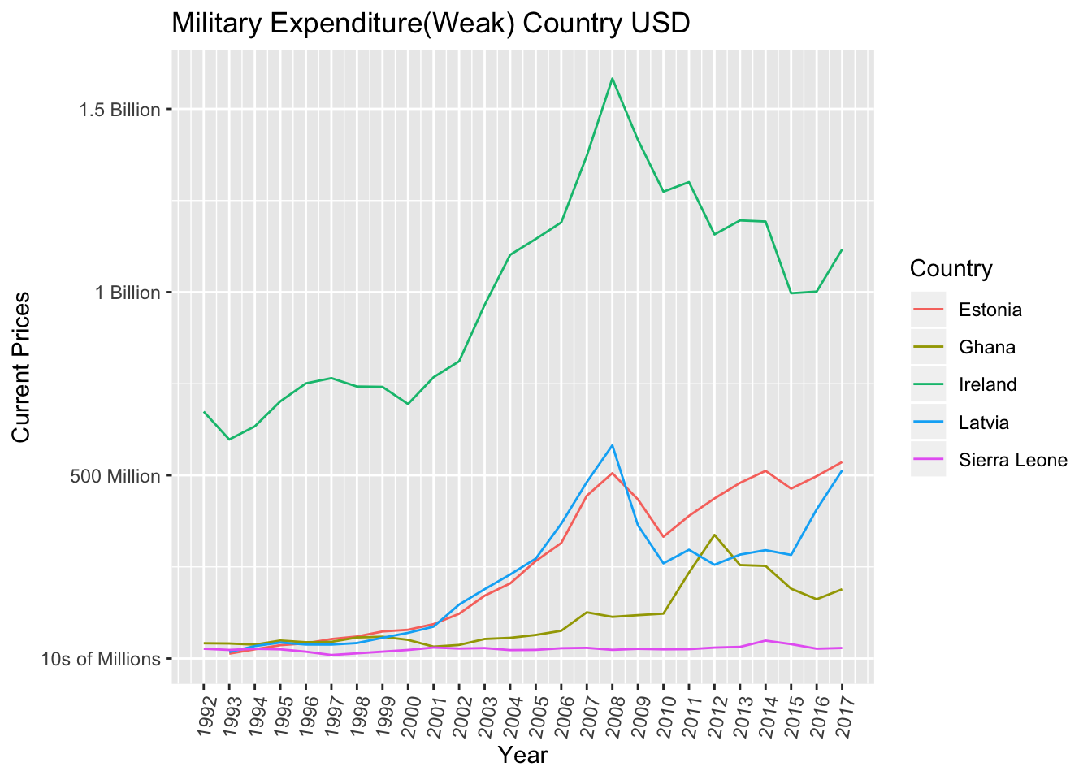
Military Expenditure of Strong and Weak Militaries

Slide 7
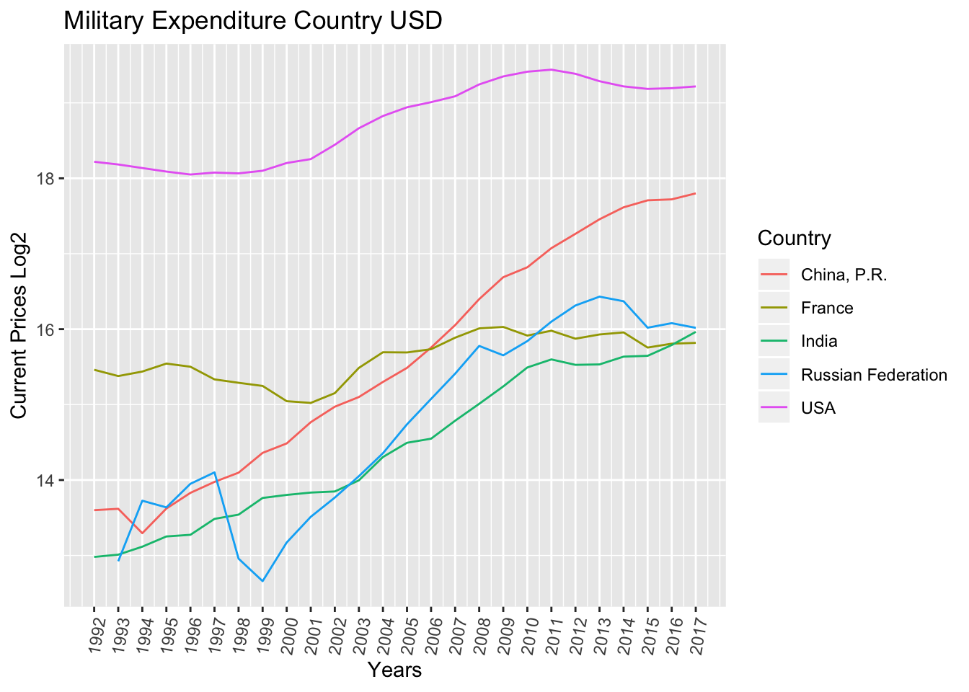
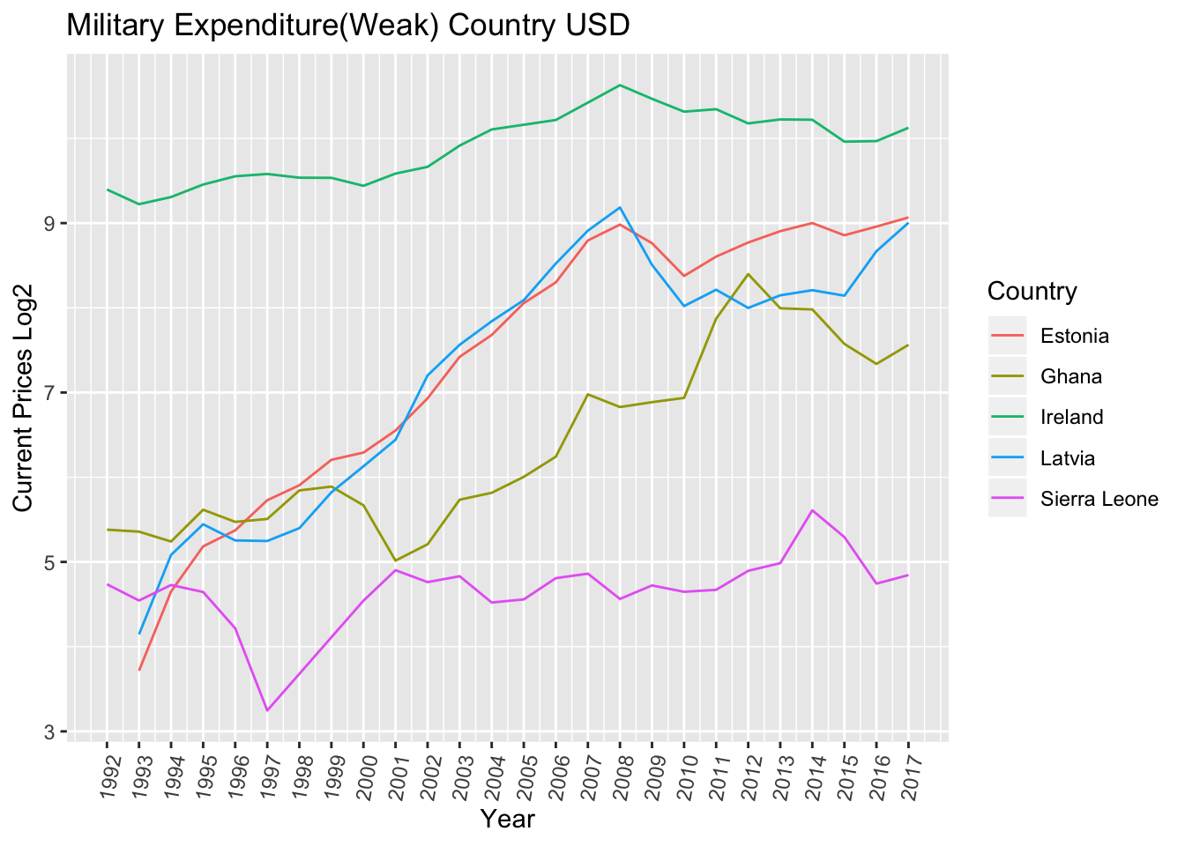
Log₂(Military Expenditure) of
Strong and Weak Militaries

Slide 8
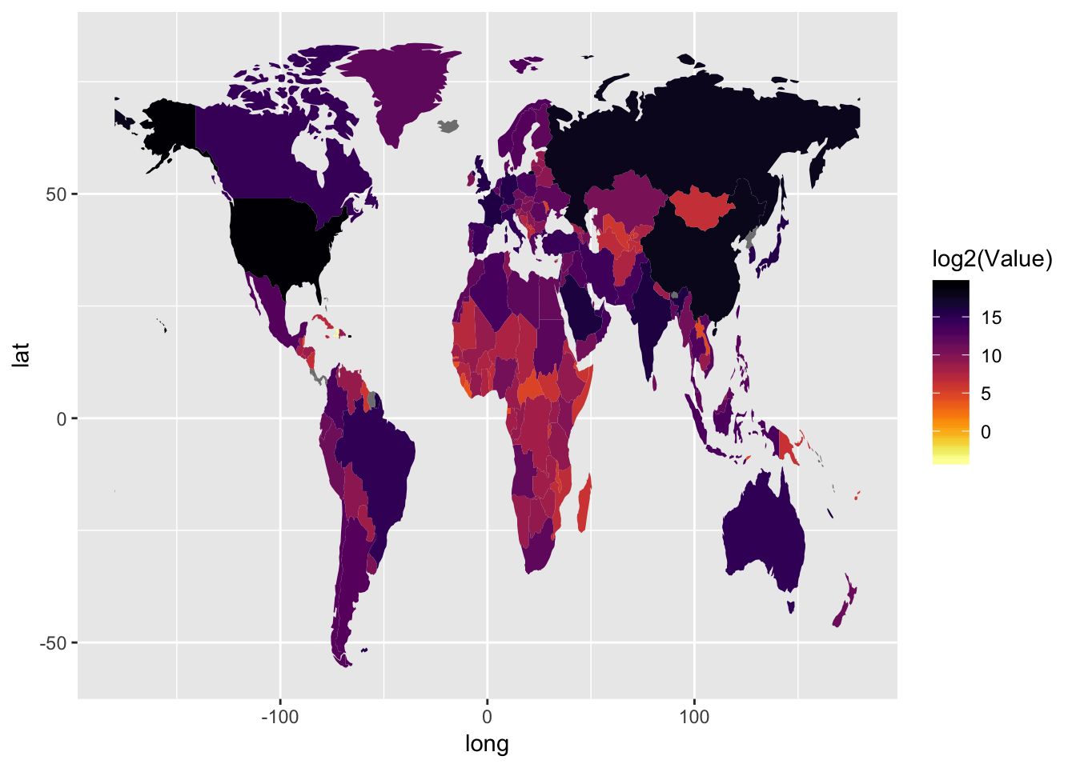
Military Expenditure World Map

Slide 9
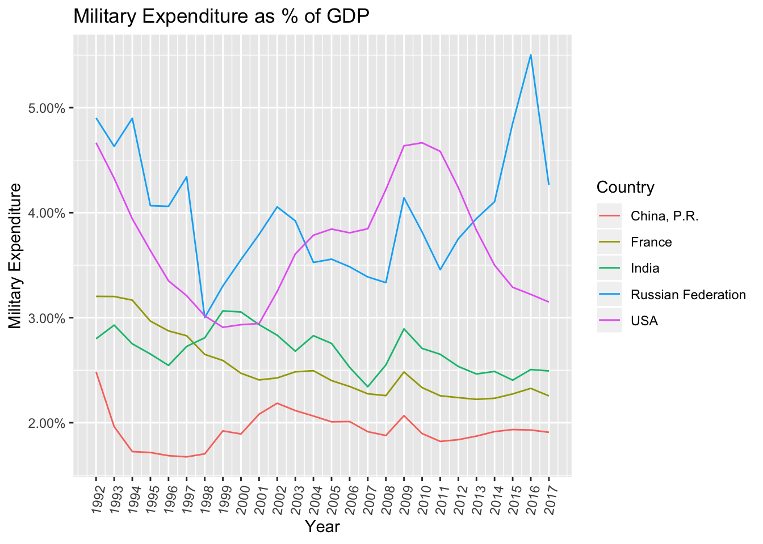
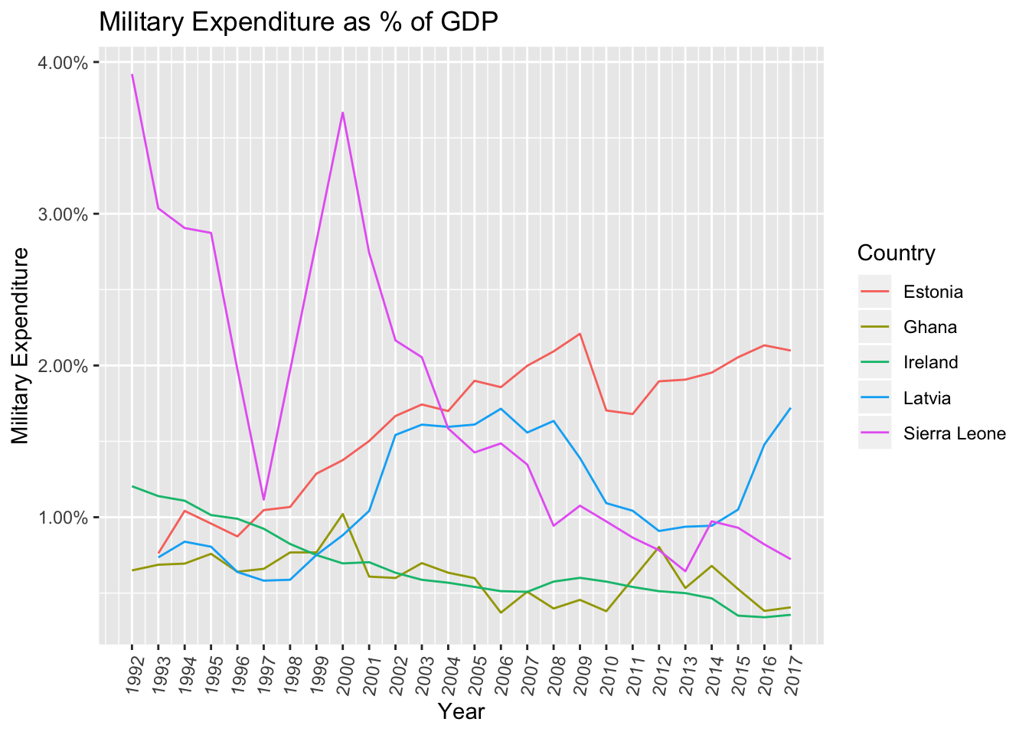
Military Expenditure
as Share of GDP

Slide 10
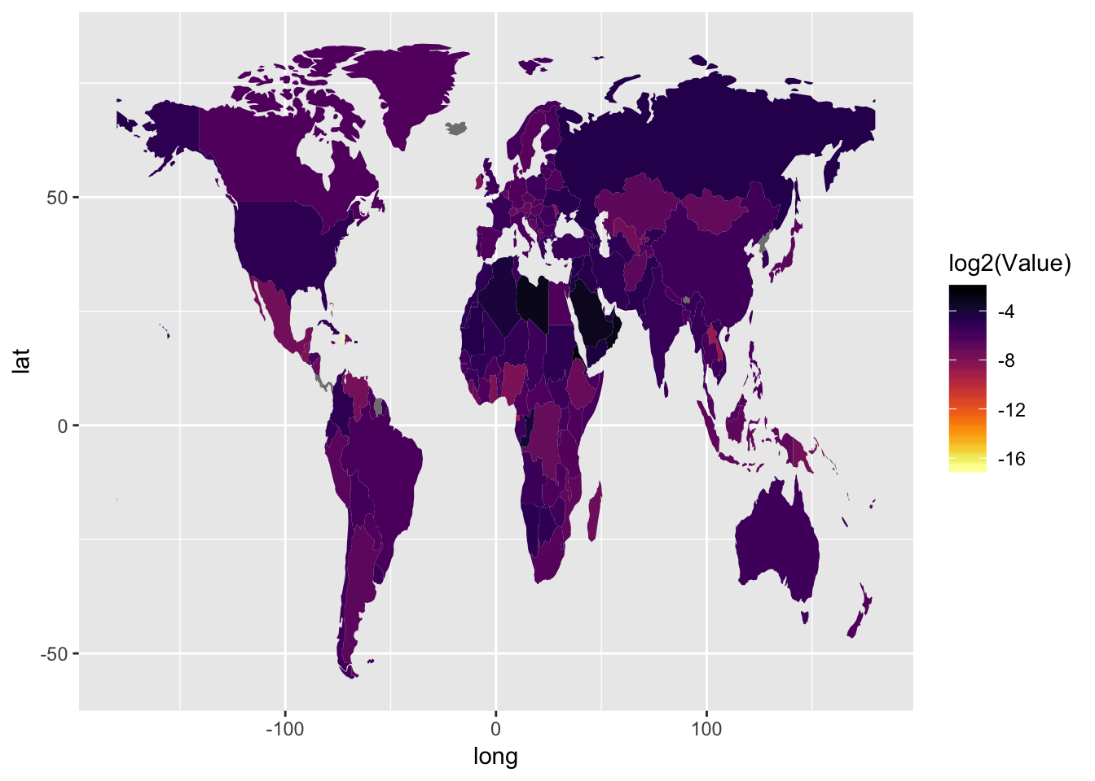
Expenditure as share of GDP World Map

Slide 11
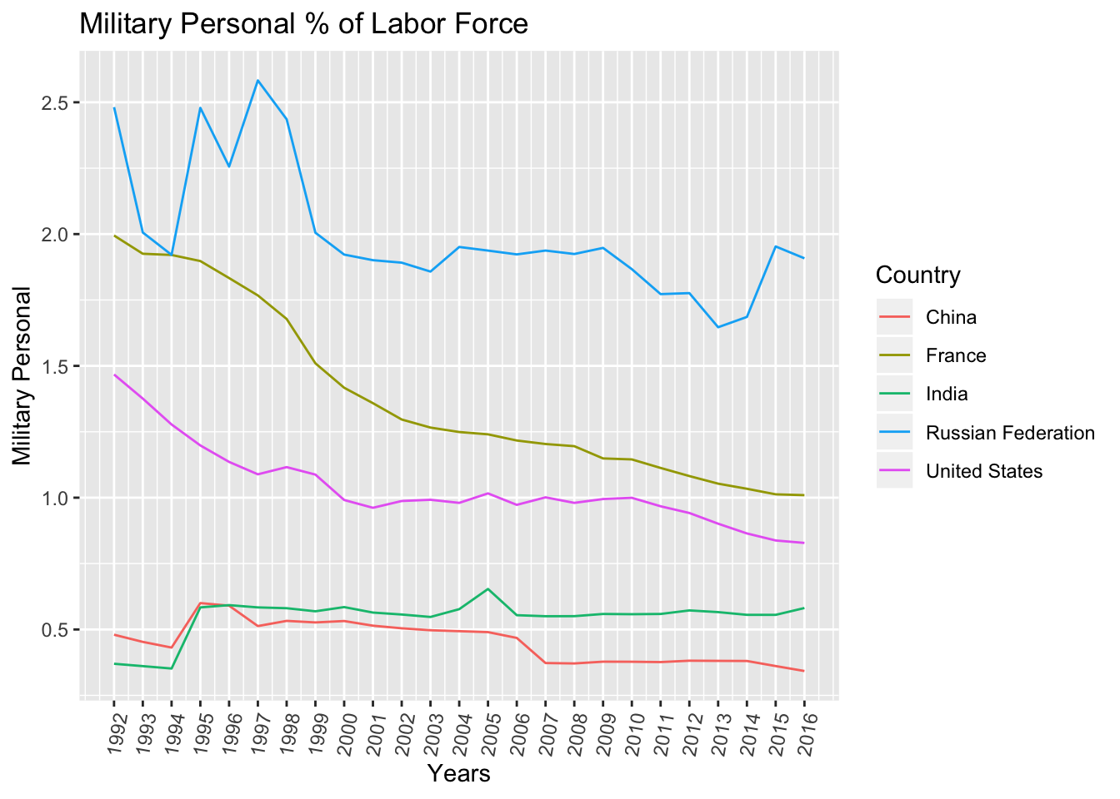
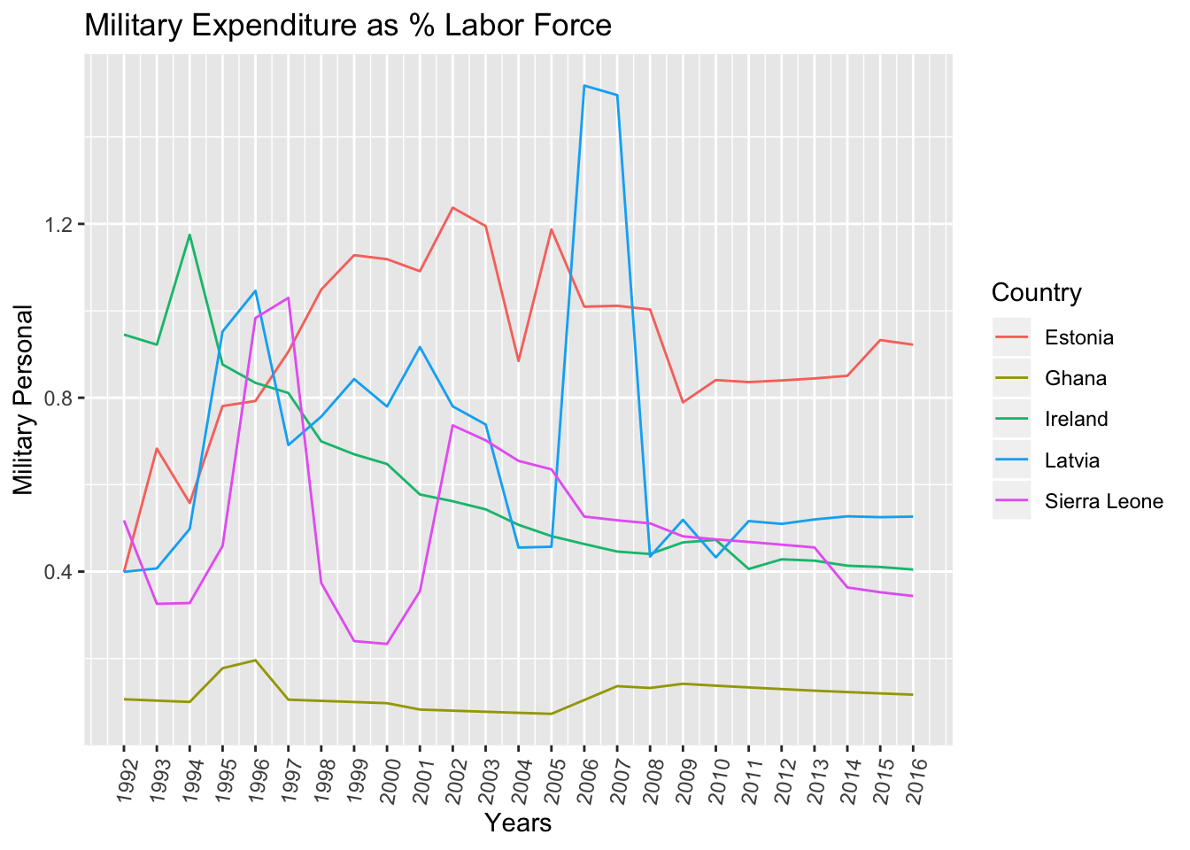
Military Personnel
(as % of total labor force)

Slide 12
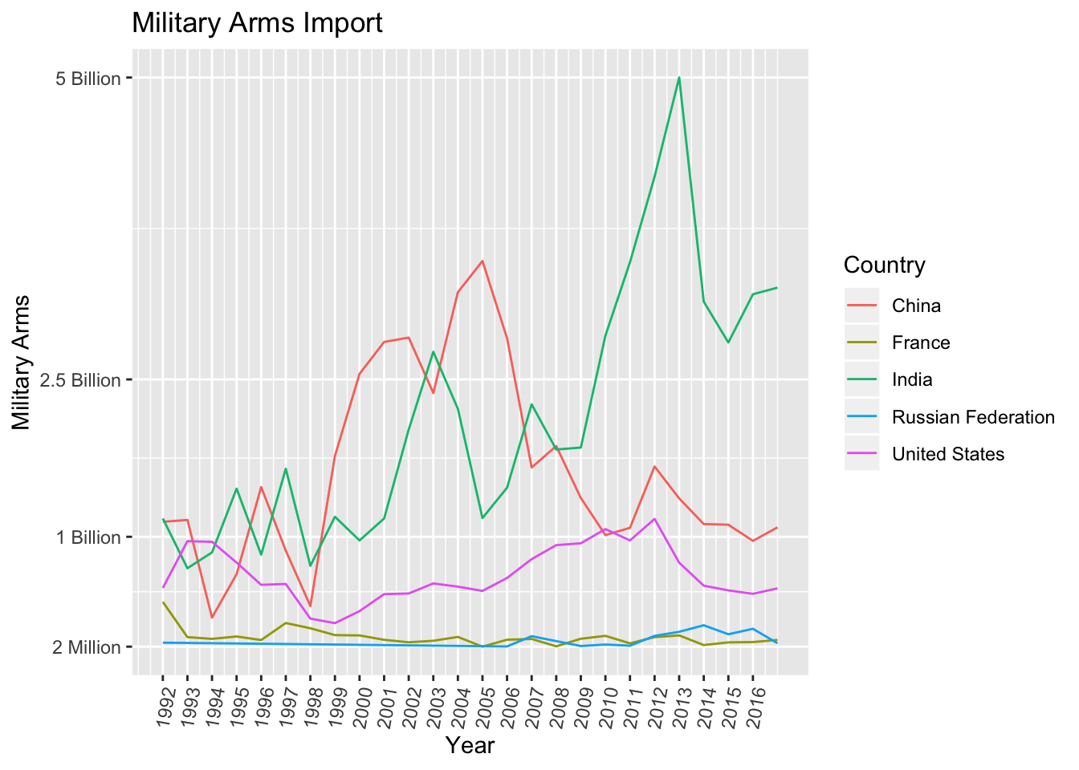
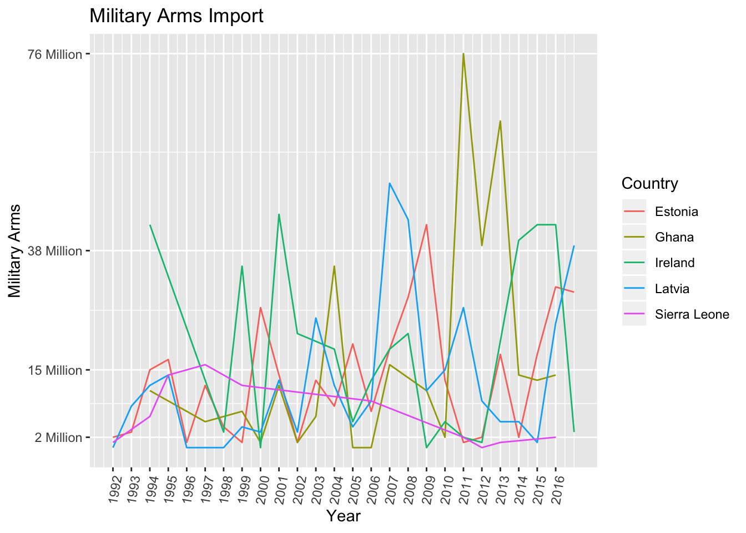
Military Arms
Imports

Slide 13
Global Firepower Summary
Total Aircraft Strength
Min | 1305
1st Qu | 2102
Median | 2955
Mean | 4784
3rd Qu | 3794
Max | 13762
Total Helicopter Strength
Min | 610
1st Qu | 666
Median | 912
Mean | 1928
3rd Qu | 1389
Max | 6065
Combat Tanks
Min | 406
1st Qu | 4426
Median | 5884
Mean | 7478
3rd Qu | 6457
Max | 20216
Armored Fighting Vehicles
Min | 4788
1st Qu | 6704
Median | 6863
Mean | 18143
3rd Qu | 31298
Max | 41062
Self-Propelled Artillery
Min | 290
1st Qu | 325
Median | 1710
Mean | 2046
3rd Qu | 1934
Max | 5972
Total Naval Assets
Min | 118
1st Qu | 295
Median | 352
Mean | 378.8
3rd Qu | 415
Max | 714
Total Aircraft Strength
Min | 4
1st Qu | 4.75
Median | 5.5
Mean | 10
3rd Qu | 10.75
Max | 25
Total Helicopter Strength
Min | 4
1st Qu | 4
Median | 4.5
Mean | 6.75
3rd Qu | 7.25
Max | 14
Combat Tanks
Min | 0
1st Qu | 0
Median | 0
Mean | 0.5
3rd Qu | 0.5
Max | 2
Armored Fighting Vehicles
Min | 10
1st Qu | 190
Median | 275
Mean | 219.5
3rd Qu | 304.5
Max | 318
Self-Propelled Artillery
Min | 0
1st Qu | 0
Median | 0
Mean | 0
3rd Qu | 0
Max | 0
Total Naval Assets
Min | 6
1st Qu | 9
Median | 14
Mean | 13.5
3rd Qu | 18.5
Max | 20

Slide 14
Conclusion
[some conclusion about the strength of militaries]

Slide 15
QUESTION 2
How did the cartels affect Mexico’s military?

Slide 16
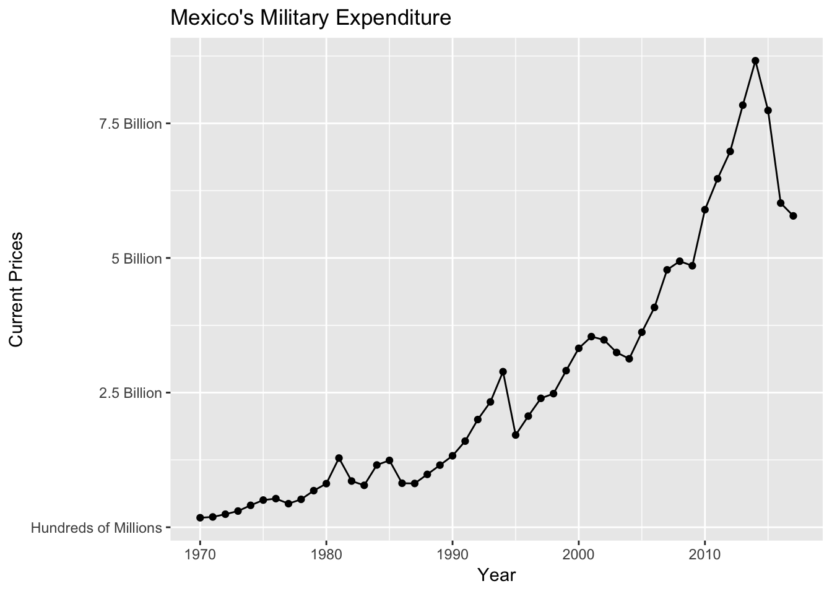
Plot 1

Slide 17
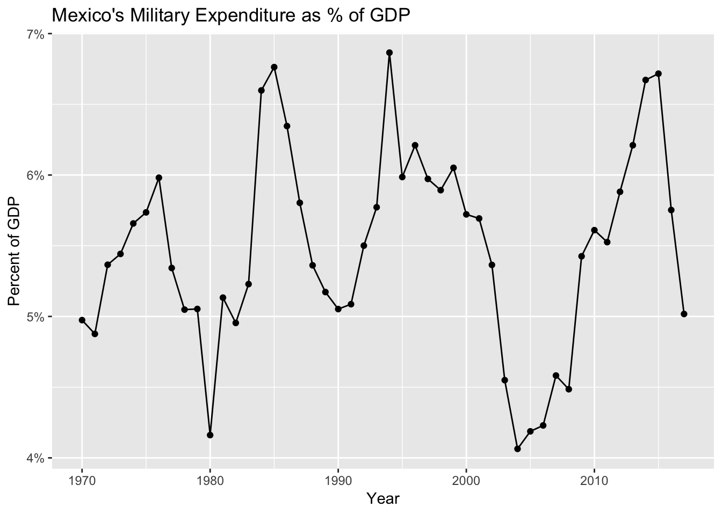
Plot 2

Slide 18
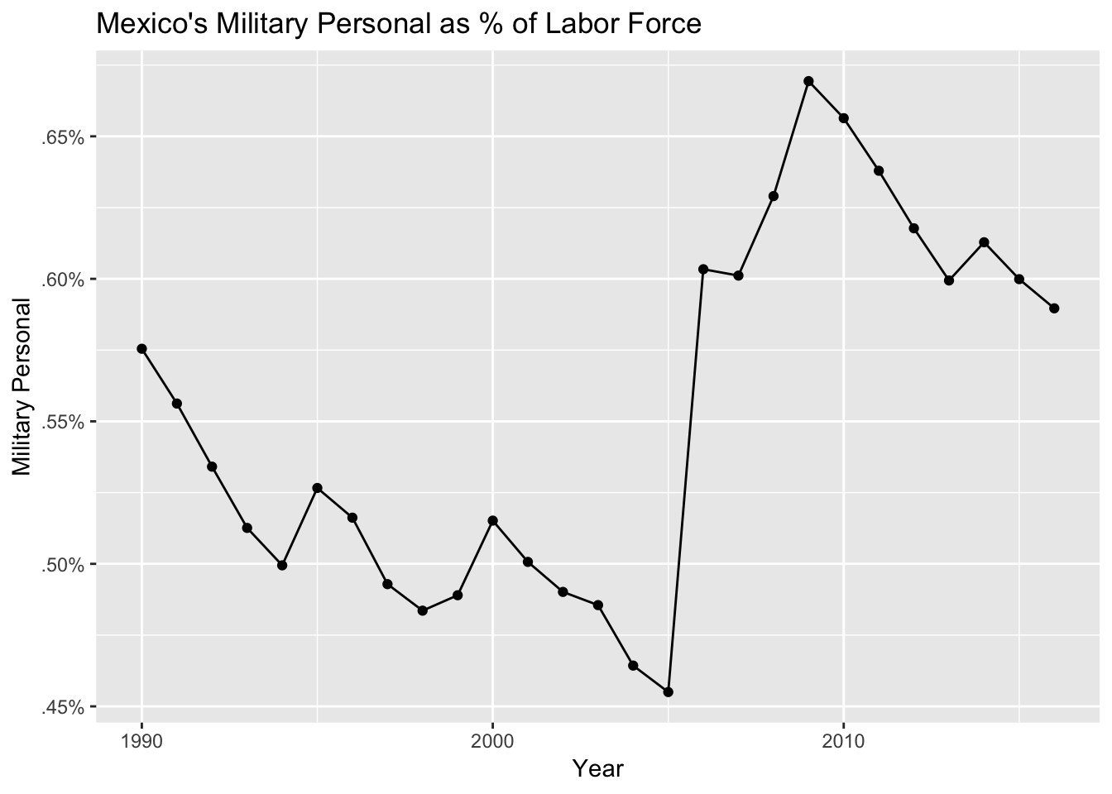
Plot 3

Slide 19
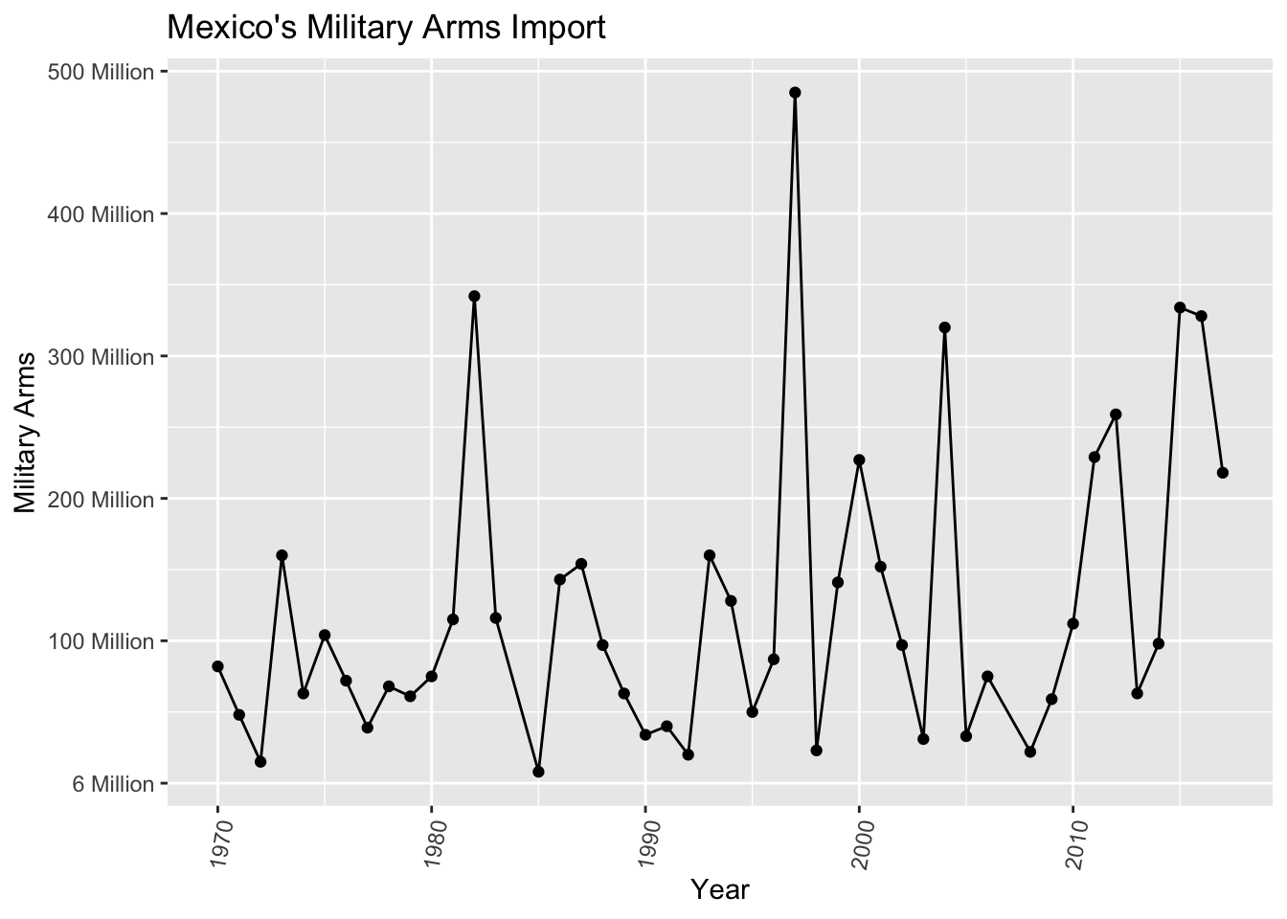
Plot 4

Slide 20
Conclusion
[Mexico’s military increased]

